Slide 1
Predicting Pressure Injuries in Veterans
Gabriel Brehm

Slide 2
The Problem
“Pressure injures (PrI) are a major secondary complication for many people with spinal cord injury (SCI). Development and/or recurrence of a PrI limits activities of daily living, often leading to hospitalization and even death. This has a devastating impact on affected individuals and their caregivers.” –BEIPIR Specific Aims A01
Some veterans are victims of recurrent pressure injuries, some get them rarely or not at all.
Additionally, IMAT builds quickly for some with spinal cord injuries, and slowly or not at all for others.
Previous research has indicated a relationship between intra-muscular adipose tissue (IMAT) and the occurrence of pressure injuries.

Slide 3
Research Aims
“…central hypothesis: DNA variants predispose some individuals to increased deposition of IMAT following spinal cord injury, and resultant increased PrI risk.”
SPECIFIC AIM 1: Determine the association of muscle composition with genetic profiles.
Via DNA assay of 38 previously-collected samples
SPECIFIC AIM 2: Update and validation of the BEIPIR model of personalized pressure injury risk.
Via DNA assay of ~100 new samples from longitudinally-tracked veterans meeting specific criteria and with varying IMAT.

Slide 4
Supplementary Aims
“The overarching question guiding Dr. Graves’ research interest is ‘how can symptom science be used to help explain, predict, and mange [sic] symptoms (also known as SHC’s) following spinal cord injury?’” –Graves Supplementary SpAims, May 21 2022
SPECIFIC AIM 1: Conduct secondary analysis of existing whole blood and muscle tissue collected from the Bogie Labs prior studies to run epigenome wide analysis (EWAS) to discover genes presented differentially in the two tissue types.
SPECIFIC AIM 2: Conduct a retrospective secondary analysis on the SCI-PIR database… Machine learning methods will be applied to extract and identify common symptoms and/or risk factors post SCI. “cluster” classifications of symptoms/SHCs after SCI will be developed including for those with and without a history of pressure injuries. This aim will lay the groundwork toward developing a multisymptom inventory assessment specific [to] Veterans living with SCI.

Slide 5
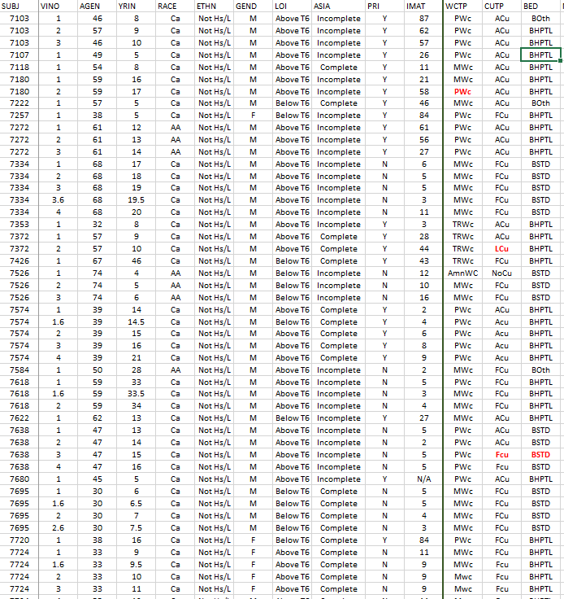
The Data
Data collection for the study is ongoing; what follows is a preliminary analysis of the “pilot” data.
The data set describes anonymized medical information for 103 veterans with varying levels of spinal cord injury.

Slide 6
Variables
There are 54 potentially predictive variables; many participants have missing data in one of them.
(2 other variables are the Subject ID and Visit Number)
10 variables are continuous; the remaining are categorical.
Some potentially interesting variables include: Occurrence of pressure injuries, IMAT, age, years injured, gender, level of injury, nature of paralysis, etc.

Slide 7
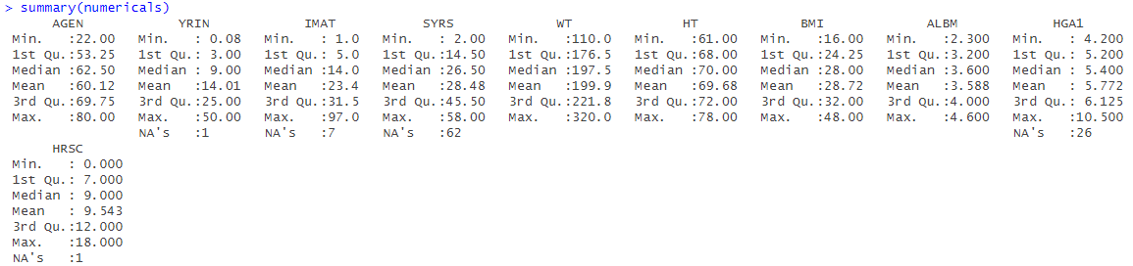
EDA – continuous variables

Slide 8
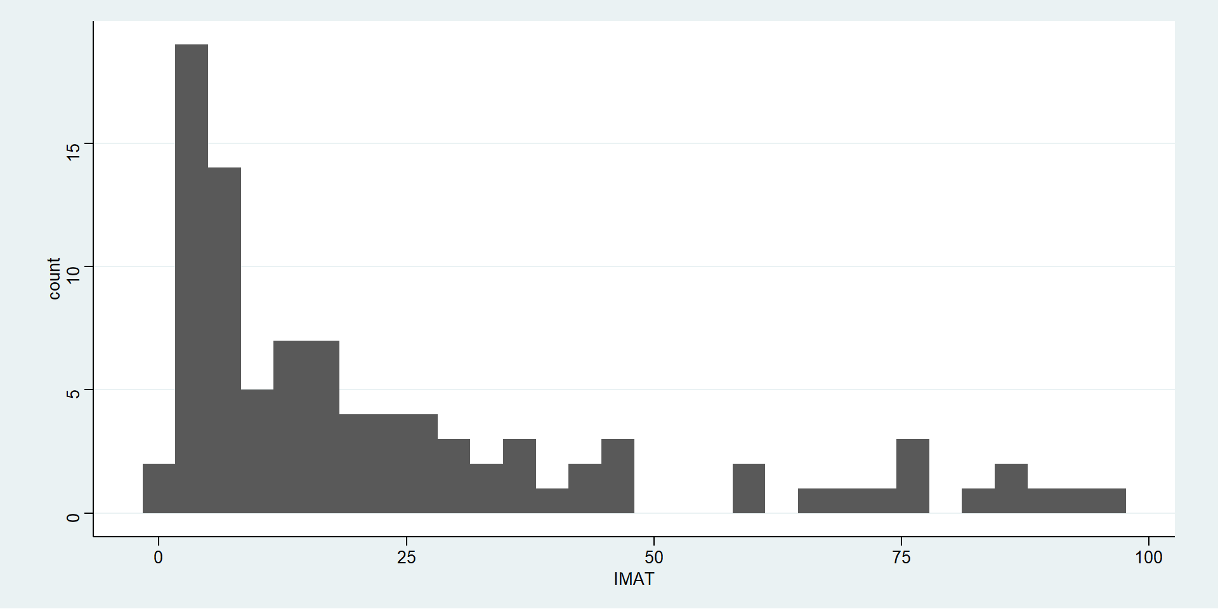
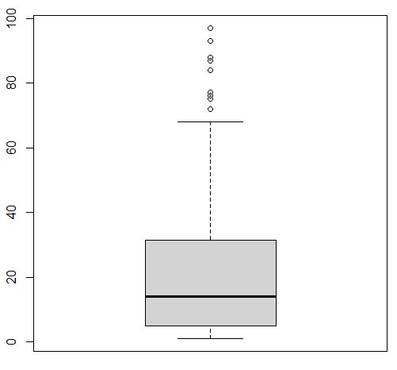
EDA – continuous variables

Slide 9
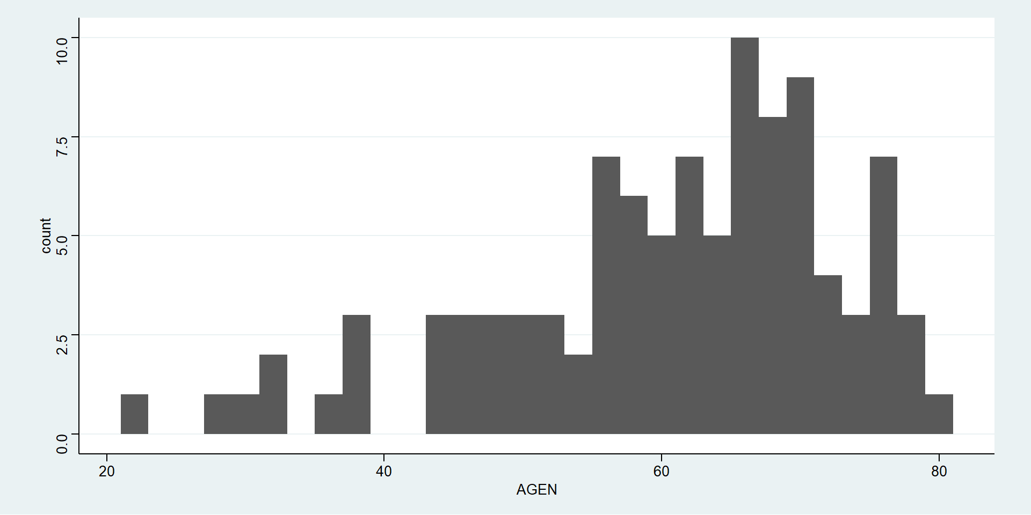
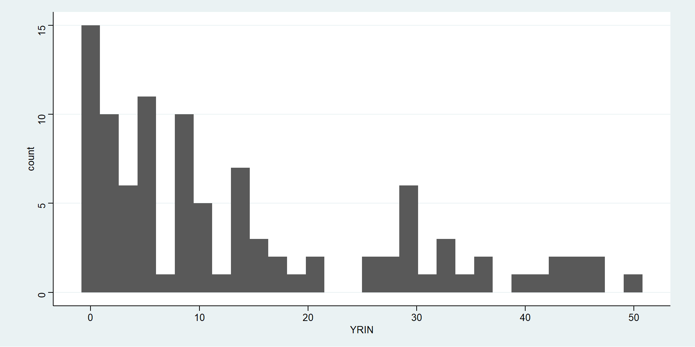
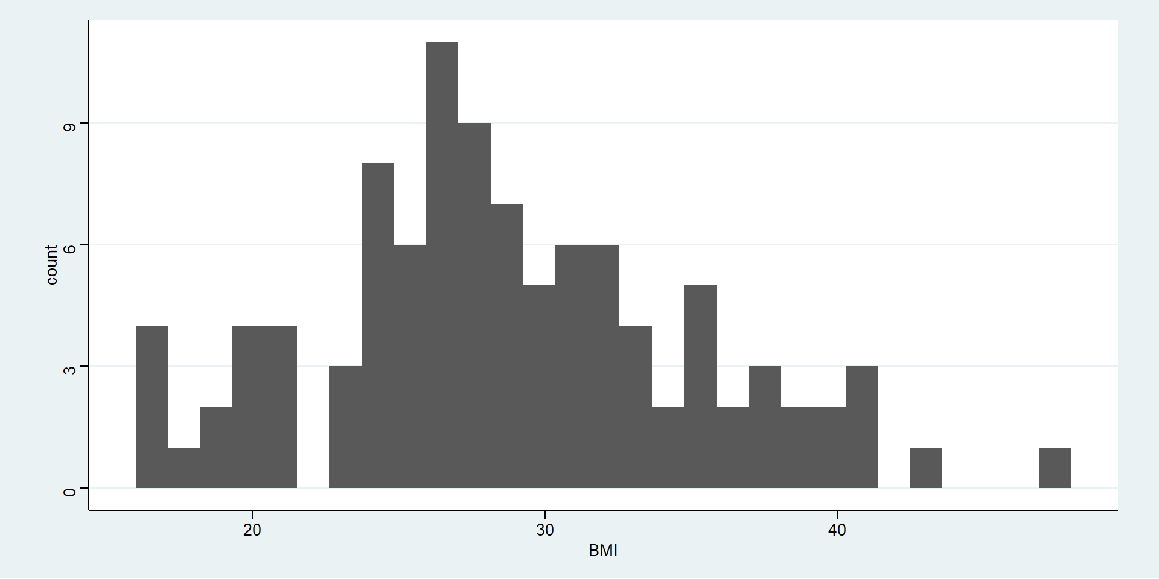
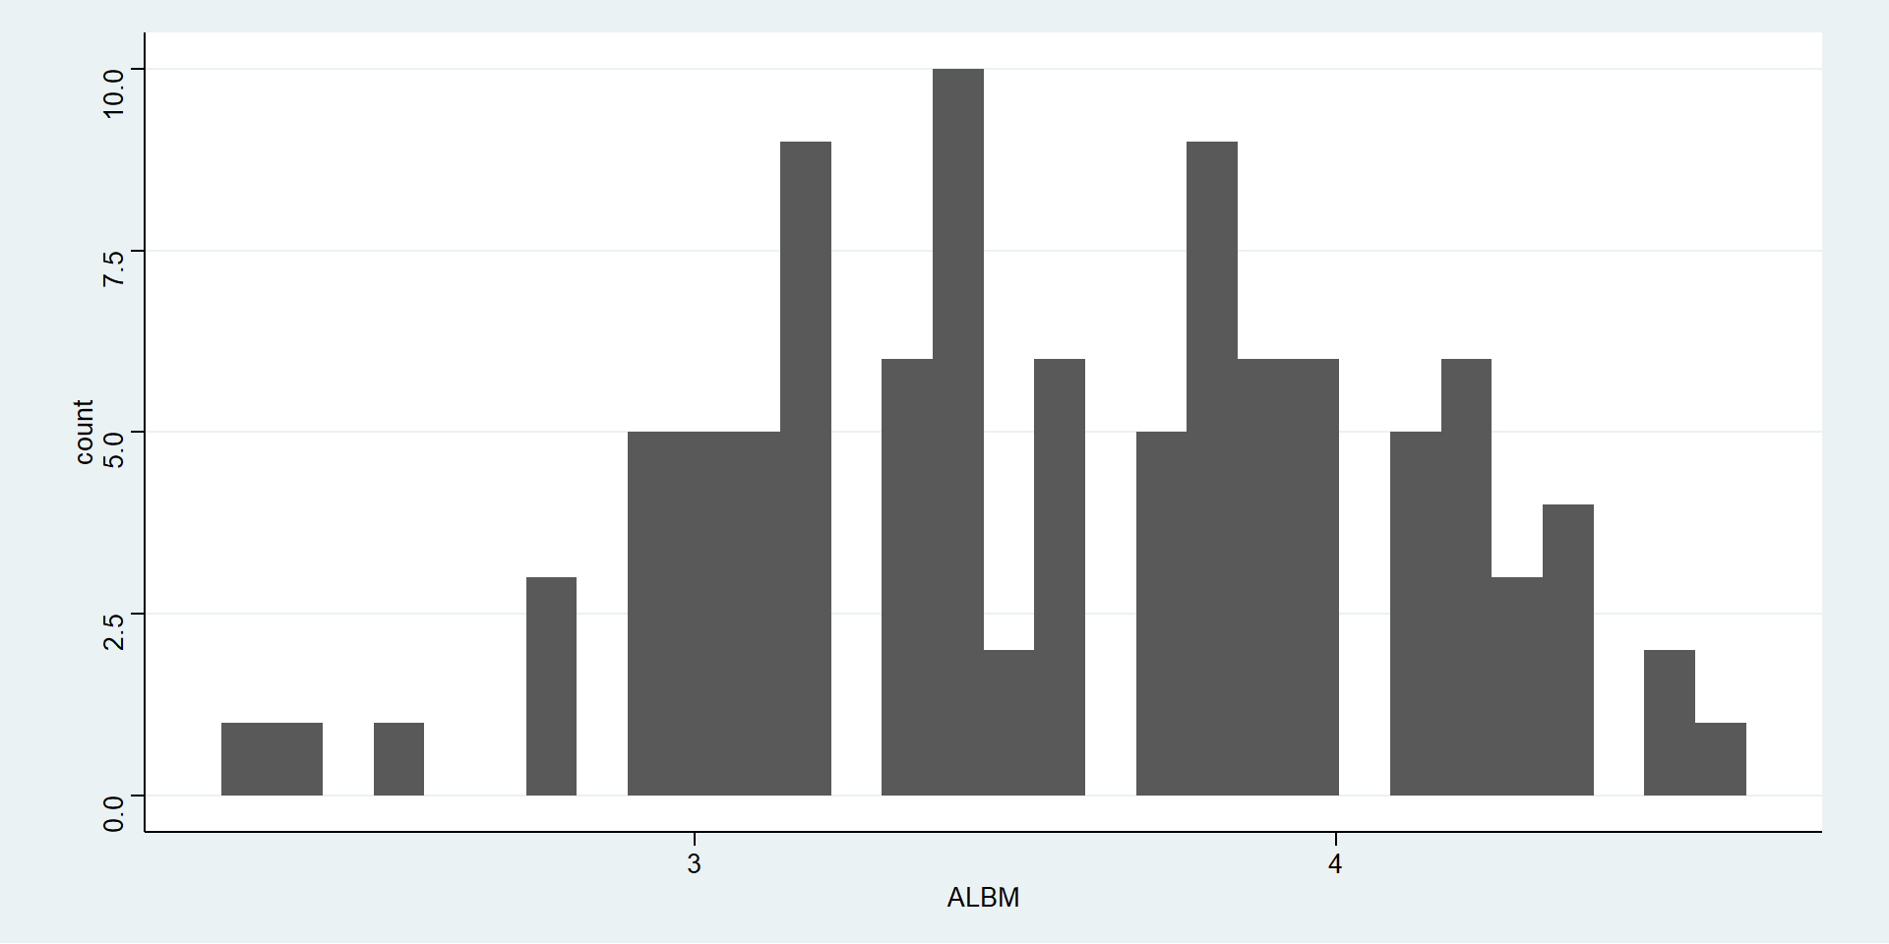
EDA – continuous variables (cont.)

Slide 10
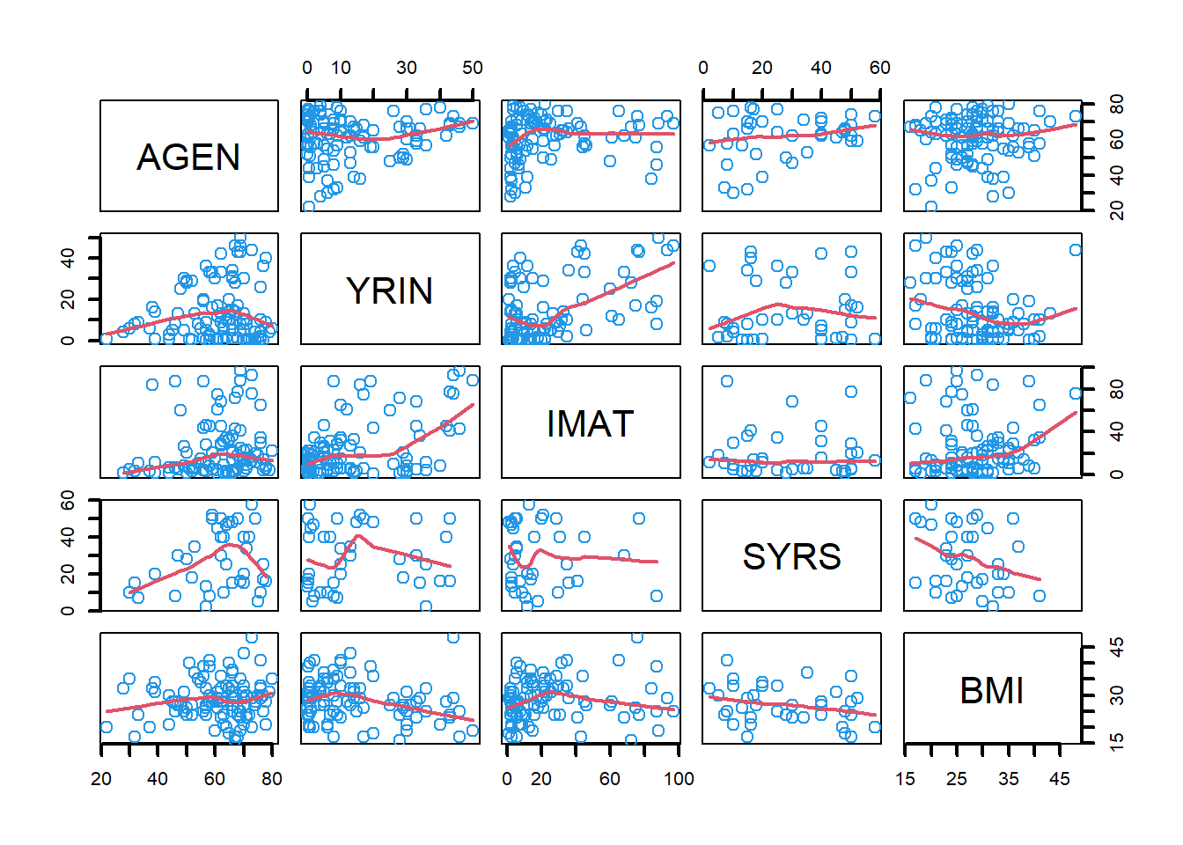
EDA – continuous variables (cont.)

Slide 11
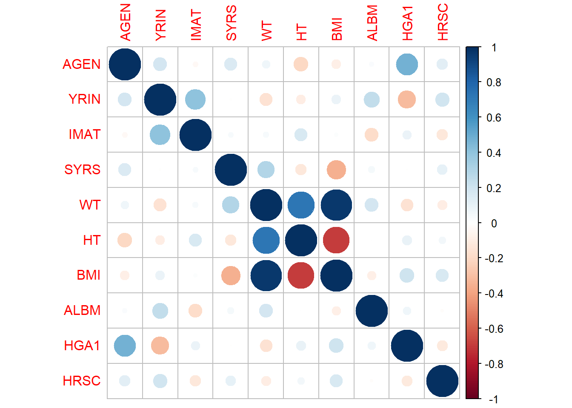
EDA – continuous variables (cont.)
Partial correlations – correlations between variables after conditioning on all the other variables.
Doesn’t include categorical variables, but conditioning can only reduce correlations so there are no false negatives here.

Slide 12
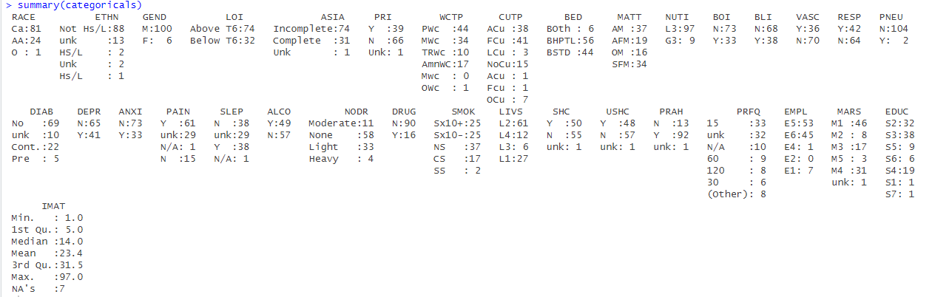
EDA – categorical variables

Slide 13
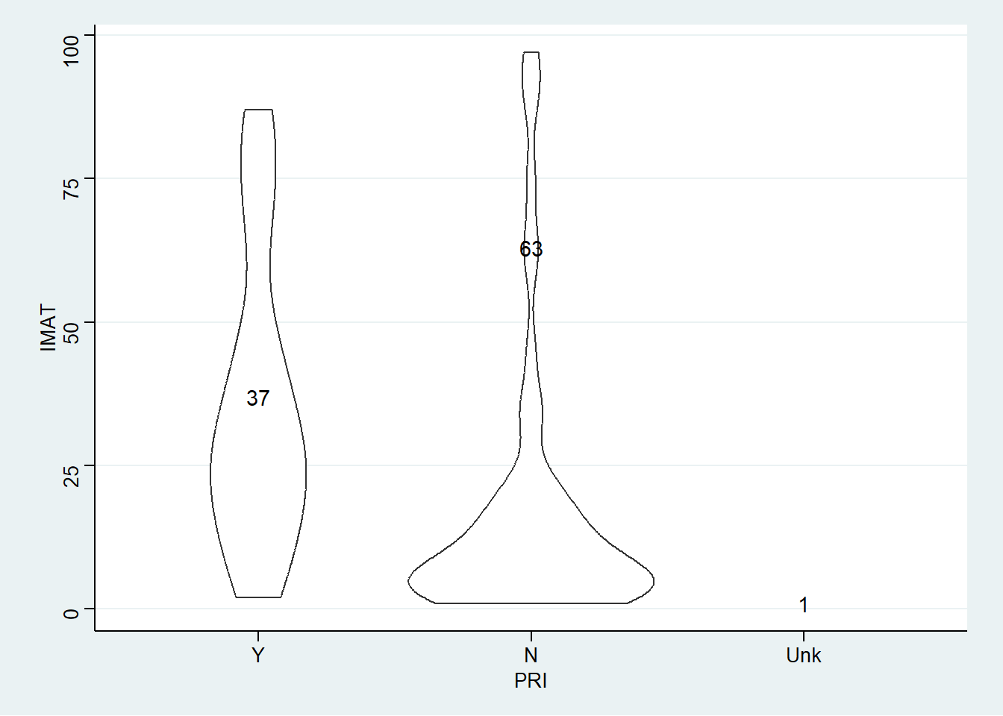
EDA – categorical variables

Slide 14
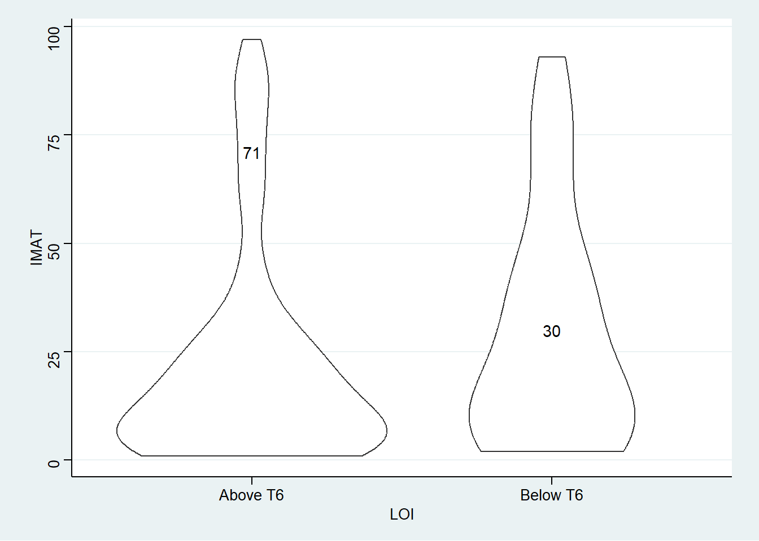
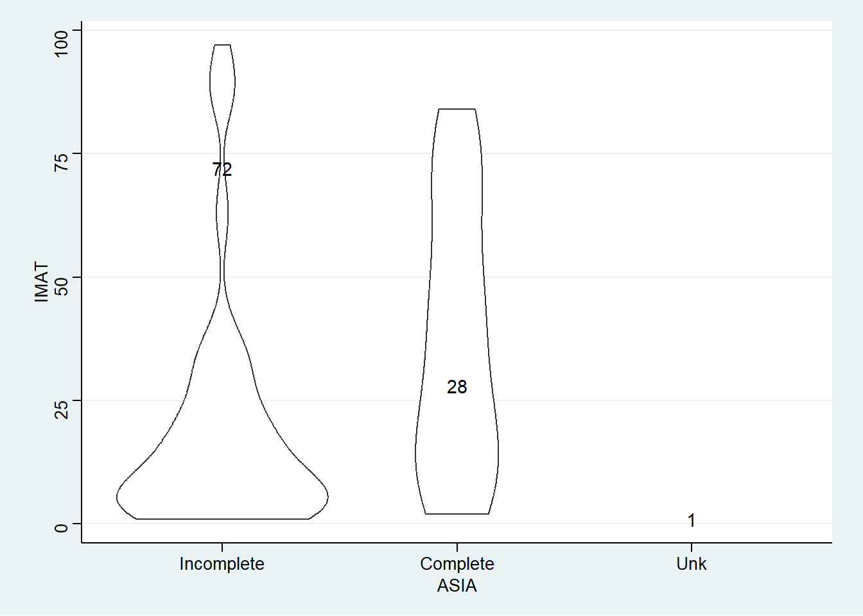
EDA – categorical variables (cont.)

Slide 15
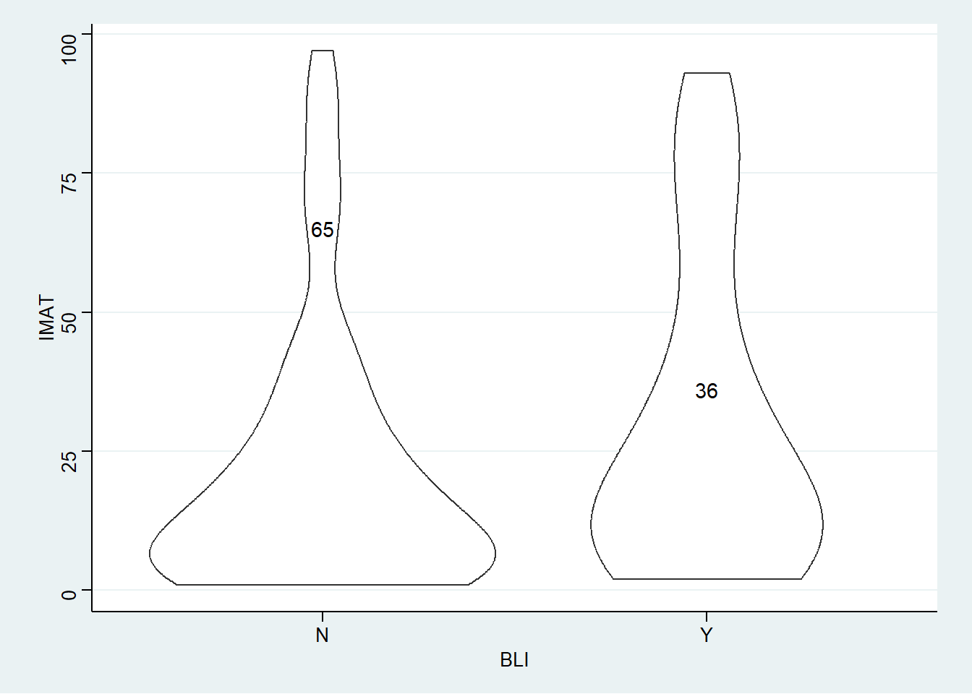
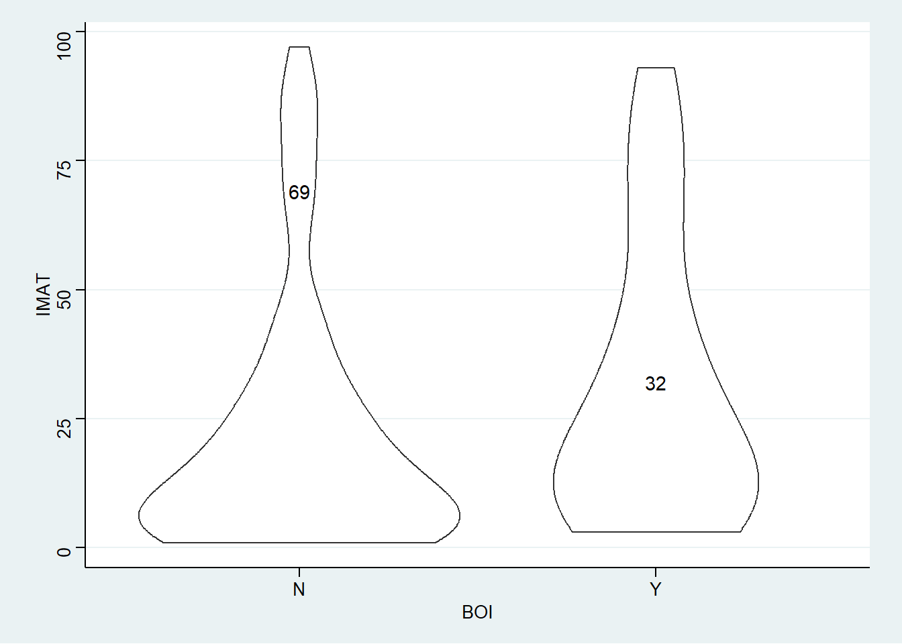
EDA – categorical variables (cont.)

Slide 16
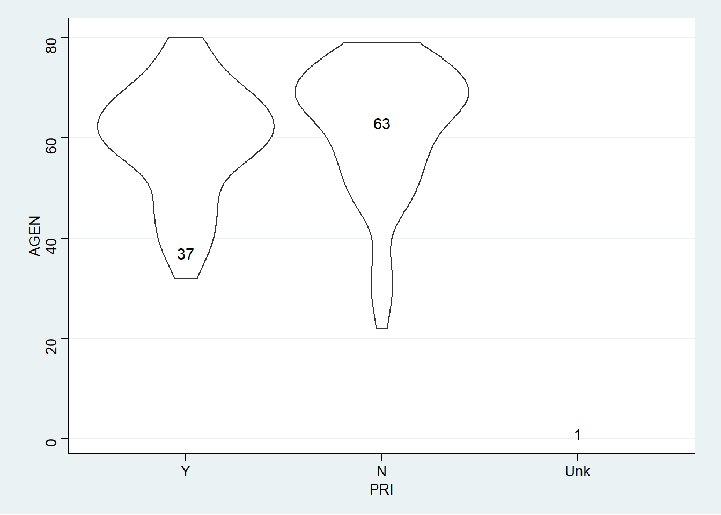
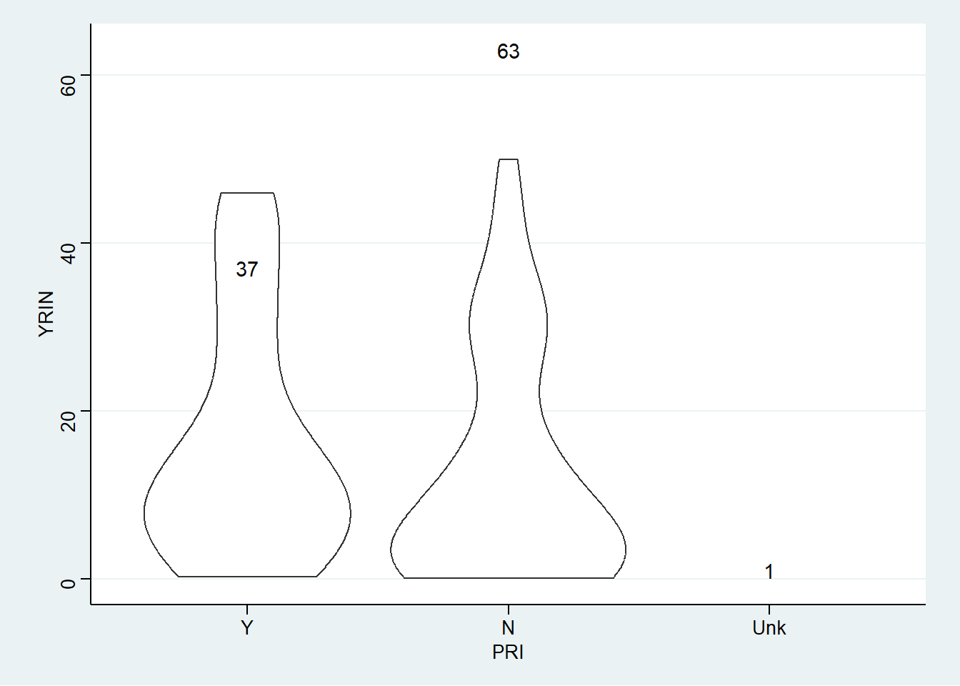
EDA – categorical variables (cont.)

Slide 17
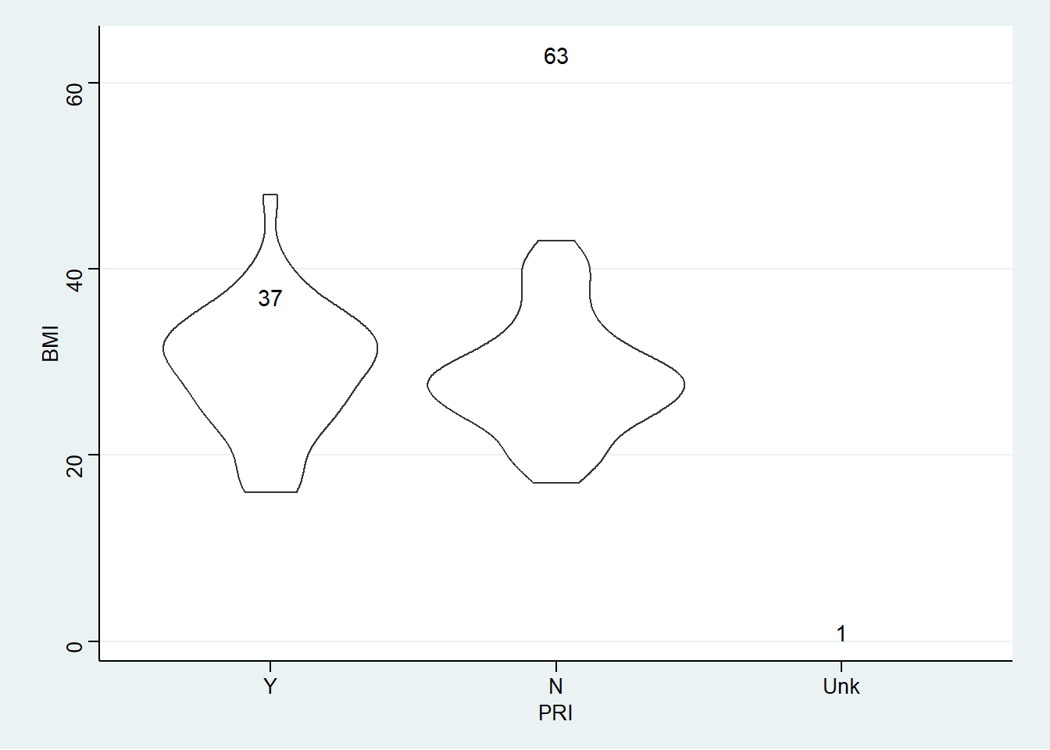
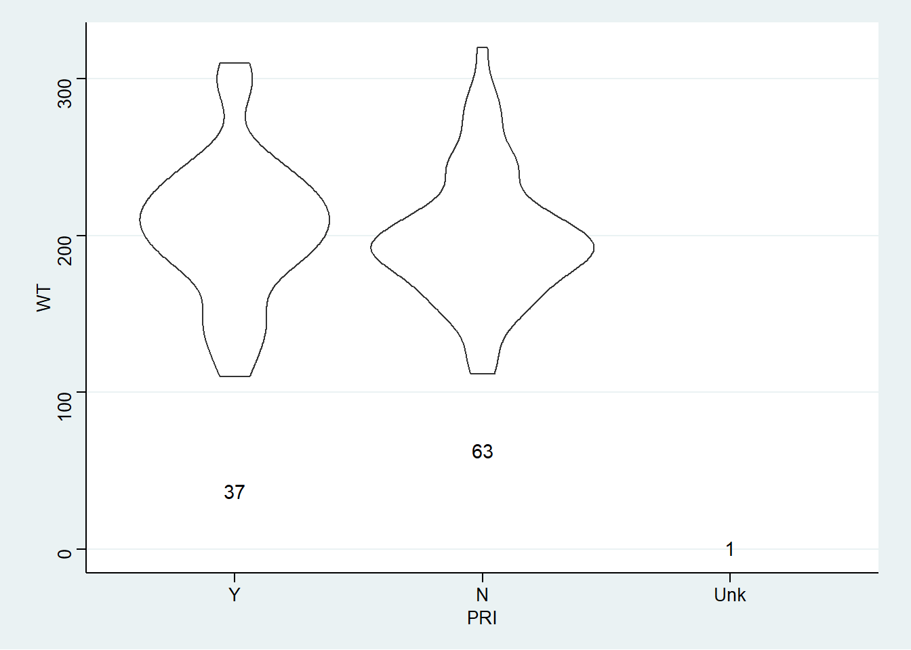
EDA – categorical variables (cont.)

Slide 18
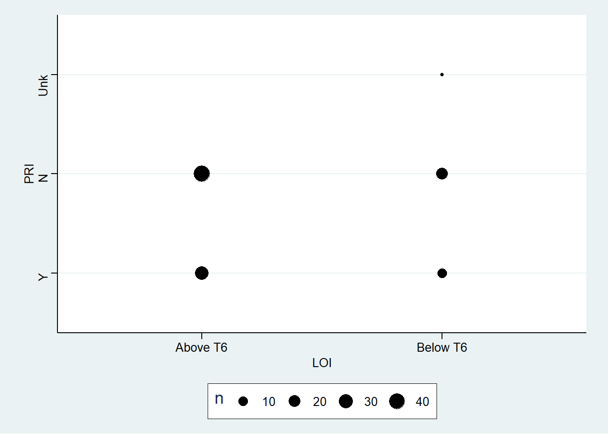

EDA – categorical variables (cont.)

Slide 19
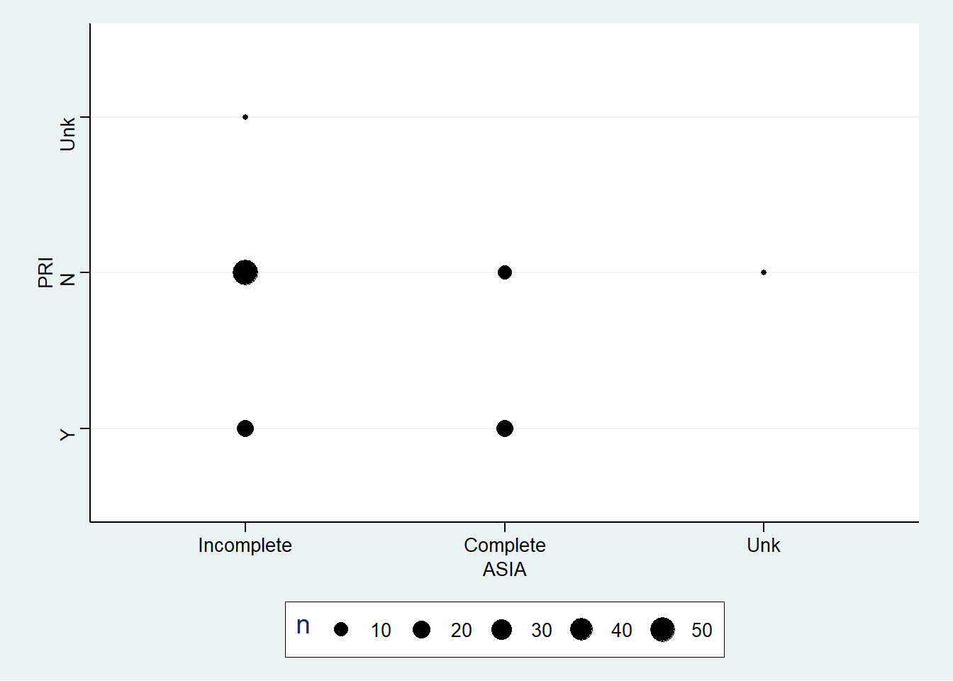

EDA – categorical variables (cont.)

Slide 20
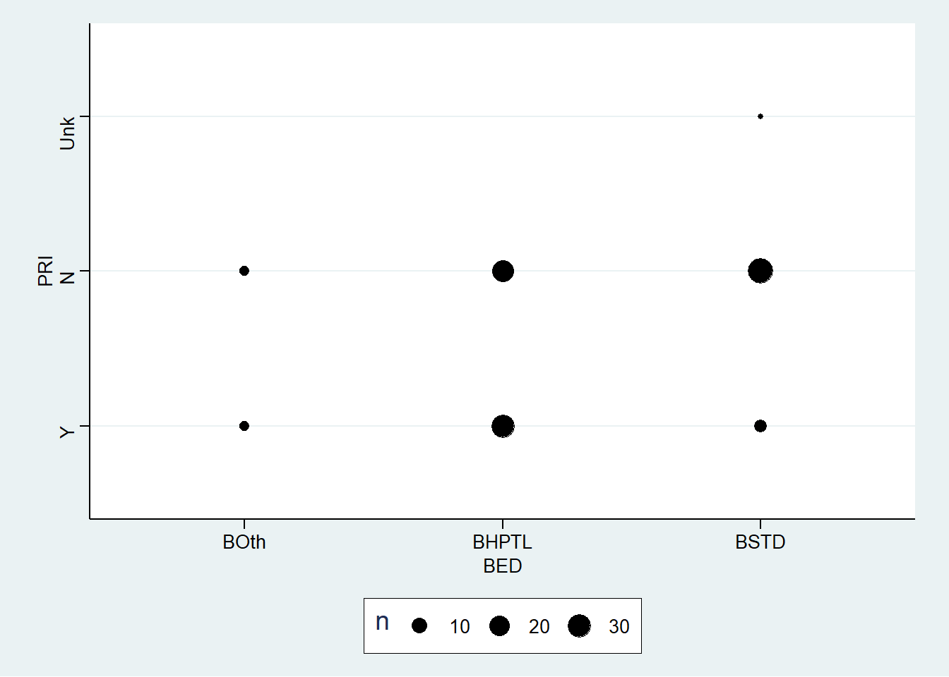

EDA – categorical variables (cont.)

Slide 21
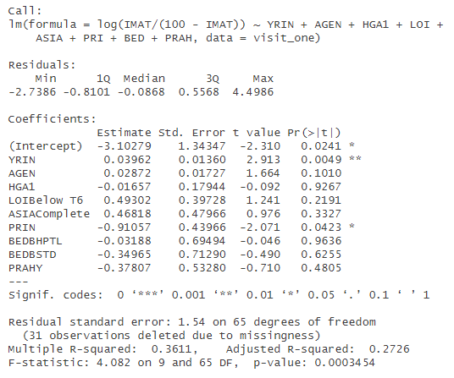
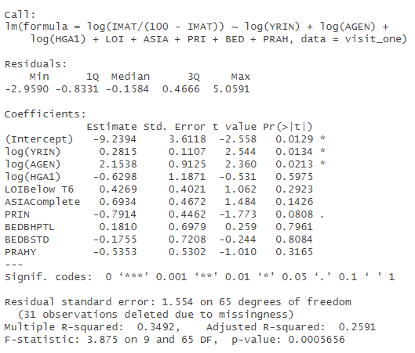
Preliminary Models

Slide 22
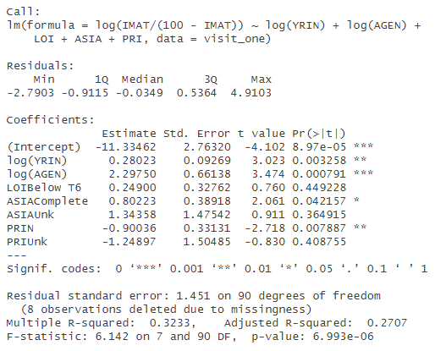
Preliminary Models (cont.)
This model’s predictors are nearly all significant.
The predictors make sense – age, years of injury, nature of the injury, and presence of pressure injuries all predict IMAT.
Next step – try other types of models: CART, GLM, etc.

Slide 23
Next Steps
There are more models to build using pilot data, as just described: CART, GLM, etc.
We are waiting on genetic data to incorporate into the model and begin fulfilling primary research aims.
Need further data complete a “multisymptom inventory assessment” specific to veterans living with SCI.

Slide 24
End
Questions?

